Slide 1

E-BUZZ
Presented By :
1. Somiya Akter (221-15-5696)
2. Fabiha Chowdhury Momo(221-15-5092)
3. Hossain Ahammed(221-15-4694)

Slide 2
1
OBJECTIVE
To create a user-friendly and efficient e-commerce platform for buying and selling products in online.
DIU| 2024

Slide 3
2
OVERVIEW
Introduction
Objectives
Users and Stakeholders
Existing Solutions in Market/Web
Implementation Requirements
Challenges of This Project and How You Overcame
Screenshot of Currently Developed Application
Name of Features
Application of OOP in Your Project
Conclusion
Implementation
DIU| 2024

Slide 4

3
INTRODUCTION
Welcome to our Python e-commerce project presentation. Our site aims to streamline online shopping through Python's versatility. Its significance lies in revolutionizing user experience and facilitating seamless transactions in the digital marketplace.
DIU| 2024

Slide 5
4
Existing Solutions in Market/Web:
Various e-commerce platforms like Amazon, eBay, Shopify, etc., offer similar services.
Users and Stakeholders:
Users: Customers, Sellers - Stakeholders: Website administrators, Payment gateway providers, Product suppliers
DIU | 2024

Slide 6
5
Name of Features:
1. User Authentication (Sign Up, Log In)
2. Product Listing and Search
3. Shopping Cart
4. Checkout and Payment
5. Order Tracking
6. User Reviews and Ratings
.
DIU | 2024

Slide 7
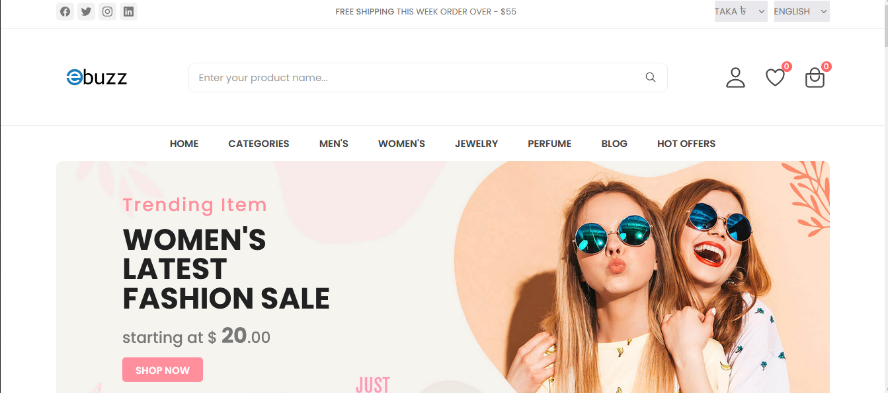
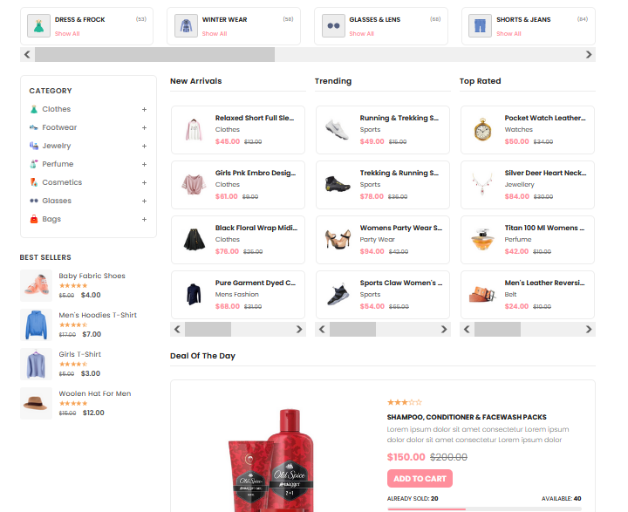
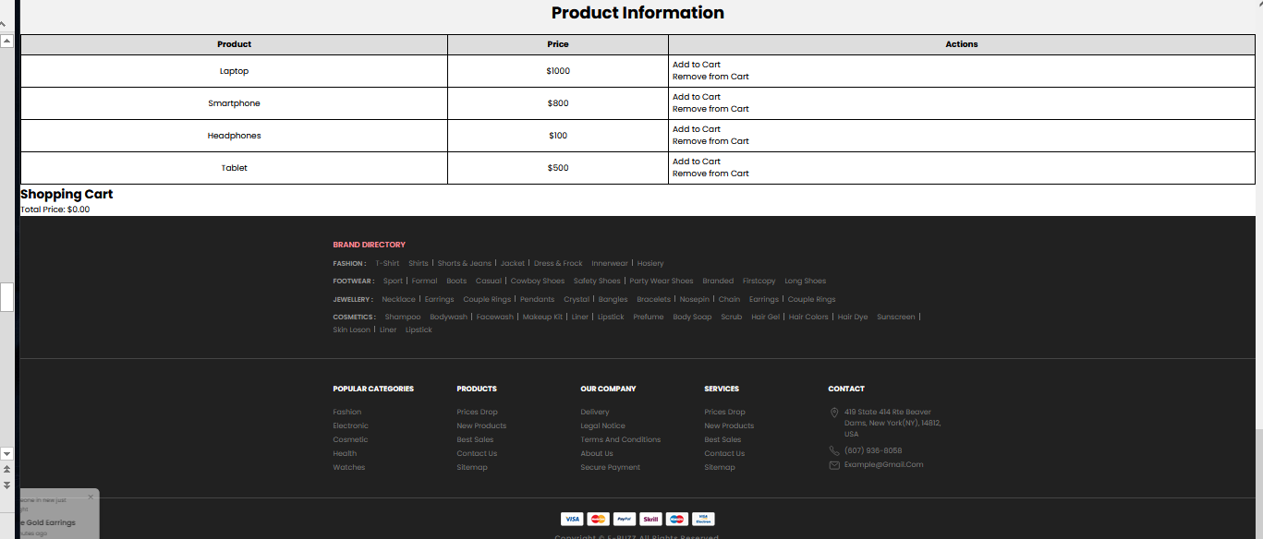
5
Screenshot of currently developed application
.
DIU | 2024

Slide 8
6
Implementation Requirements:
Frontend: HTML, CSS, JavaScript
Backend: Python (Flask framework for web development)
Database: SQLite or MySQL for storing product and user data
Hosting: Deployment on a web server (e.g., Heroku, AWS)
DIU| 2024

Slide 9
7
Application of OOP in our project
Encapsulation
Abstraction
The Product, Shopping Cart, and Recommender classes encapsulate product information, cart management, and recommendation logic, respectively.
Classes provide intuitive interfaces (add_item, remove_item, etc.) abstracting away complexities for users.
DIU I2024
Inheritance
Polymorphism
Although not explicitly demonstrated, inheritance enables code reuse and hierarchical relationships.
While not directly used, polymorphism fosters code flexibility and extensibility.

Slide 10

8
CONCLUSION
User-Centric Design:
- With an intuitive interface and seamless shopping experience, our site prioritizes user satisfaction and engagement.
Scalability and Flexibility:
- Designed with scalability in mind, our site can accommodate growth and adapt to evolving business needs.
Continuous Improvement:
- Committed to delivering value, we remain dedicated to refining our site based on user feedback and technological advancements.
DIU | 2024

Slide 11
DIU| 2024
THANK YOU

